Slide 1
Networked Services

Slide 2
Edge Router
Special type of router which mediates traffic between the internal private network and the external public internet using the external border gateway protocol (eBGP)
Edge routers are where Network Address Translation (NAT) typically occurs and where L3/L7 firewalls are located (although there may be others)
Networks can contain multiple edge routers as the failure of an edge router would mean the private network is cut off from the public internet (and vice-versa)

Slide 3
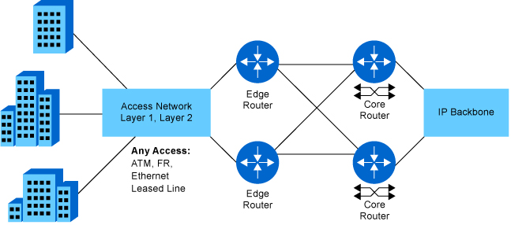

Slide 4
Dynamic Host Configuration Protocol (DHCP)
Statically assigning IP addresses to all networked devices does not scale and can lead to network errors because of misconfiguration
Rather than assigning them by hand a DHCP server is typically added to your private network so that networked devices can self-request an IP address that is unique to the private network when they join the network
For large networks you can extend your DHCP server’s reach with a DHCP relay which forwards traffic between a DHCP client and the server
DHCP then handles the majority of private IP addressing, which is especially useful for devices that are transient such as phones and laptops

Slide 5
Components of DHCP
IP Address Pool: the range of IP addresses which can be assigned to devices when requested, typically handed out from low to high
Subnets & Zones: the DHCP server can allocate IP addresses to multiple subnets but each subnet must be setup as a separate zone so that the DHCP server knows to allocate a different range for each subnet
Lease: the length of time that a DHCP client holds its IP address information. Once the lease has ended the client must renew its lease, which may mean it gets a new IP address

Slide 6
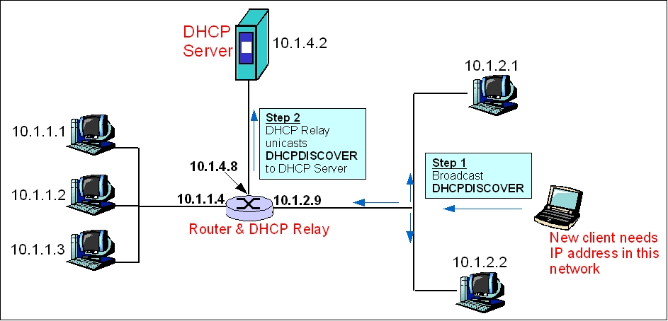

Slide 7
Domain Name Server (DNS)
Domain Name Server(s) are used to translate domain names (google.com) into IP addresses (172.217.14.68)
Most traffic will perform this translation using its local domain name cache (because its made a similar request recently) or using a public DNS servers such as those provided by Google (8.8.8.8/8.8.4.4), Cloudflare (1.1.1.1) or your internet service provider
DNS within a private network is only necessary if you want to have private domain names within your system, typically because you will be running services internally which might have IP addresses dynamically allocated to them

Slide 8
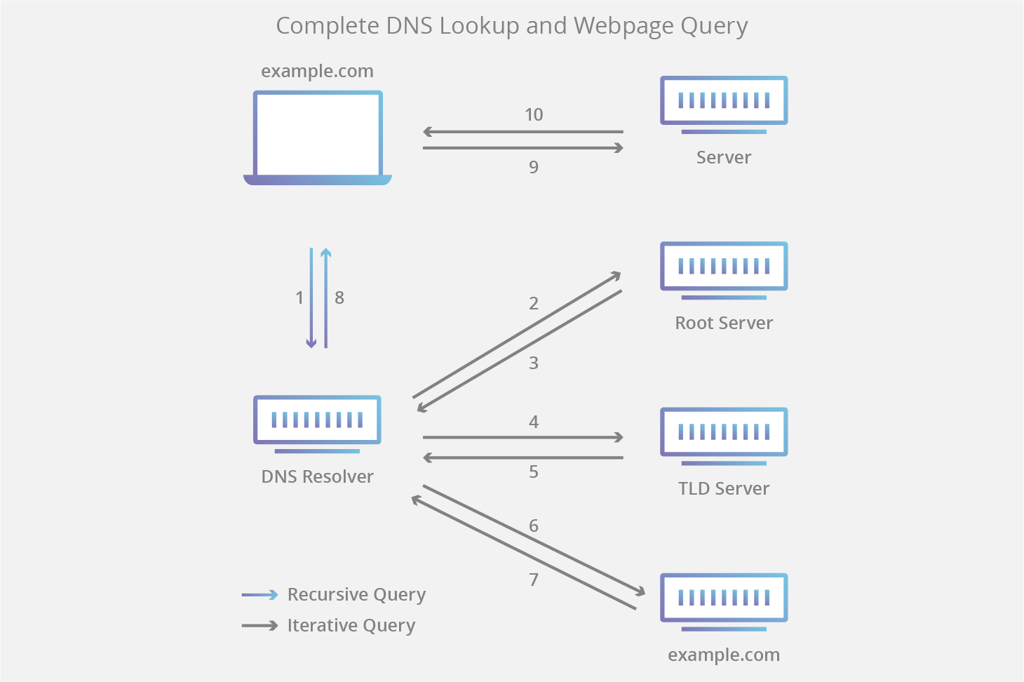

Slide 9
Common Internal Services
Local Repository Mirrors: fleet administration is much easier when there are a minimum number of host configurations. Local repository mirrors help to keep all hosts in the fleet running the same versions of the same software
FTP & Other Data Servers: often a central location for various types of data is needed for both functional (file sharing, data synchronization, etc.) and administrative (boot images, configuration files, etc.) reasons. Some of these have specialize data servers (PXE boot server) and other are done through a more generic system such as a File Transfer Protocol (FTP) server
Login Servers: users are scale are difficult to manage without centralization, so often administrative services such as LDAP or Windows Active Directory (AD) are utilized within a private network

Slide 10
Common Internal Services
Logging Datastores: reading logs from individual hosts can be difficult and make pattern finding difficult, and logs are often deleted or modified during an intrusion. To remedy these issues logs are typically centralized into a single location (with other backups) so they can be more easily queried and saved
Virtual Private Network (VPN): users often want to access private network resources when not directly connected to the private network. VPNs create an encrypted tunnel from your local network to the private network allowing you to securely access private network resources
Web Servers: if you are running websites, servers, or associated infrastructure (databases, etc.) on premises these are often within the private network and statically allocated a public IP address

Slide 11
Questions?

